Slide 1
Probability Distributions

Slide 2
Random Variable
A random variable x takes on a defined set of values with different probabilities.
    For example, if you roll a die, the outcome is random (not fixed) and there are 6 possible outcomes, each of which occur with probability one-sixth.
    For example, if you poll people about their voting preferences, the percentage of the sample that responds “Yes on Proposition 100” is a also a random variable (the percentage will be slightly differently every time you poll).
Roughly, probability is how frequently we expect different outcomes to occur if we repeat the experiment over and over (“frequentist” view)

Slide 3
Random variables can be discrete or continuous
Discrete random variables have a countable number of outcomes
  Examples: Dead/alive, treatment/placebo, dice, counts, etc.
Continuous random variables have an infinite continuum of possible values.
  Examples: blood pressure, weight, the speed of a car, the real numbers from 1 to 6.

Slide 4
Probability functions
A probability function maps the possible values of x against their respective probabilities of occurrence, p(x)
p(x) is a number from 0 to 1.0.
The area under a probability function is always 1.
Notes:
It turns out that if you were to go out and sample many, many times, most sample statistics that you could calculate would follow a normal distribution.
What are the 2 parameters (from last time) that define any normal distribution?
Remember that a normal curve is characterized by two parameters, a mean and a variability (SD)
What do you think the mean value of a sample statistic would be? The standard deviation?
Remember standard deviation is natural variability of the population
Standard error can be standard error of the mean or standard error of the odds ratio or standard error of the difference of 2 means, etc. The standard error of any sample statistic.

Slide 5
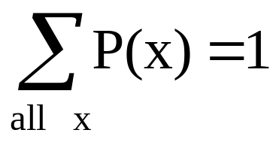
Discrete example: roll of a die
p(x)
1/6
x
1
2
3
4
5
6

Slide 6
Probability mass function (pmf)
x
p(x)
1
p(x=1)=1/6
2
p(x=2)=1/6
3
p(x=3)=1/6
4
p(x=4)=1/6
5
p(x=5)=1/6
6
p(x=6)=1/6
1.0

Slide 7
Cumulative distribution function (CDF)
1.0
P(x)
5/6
2/3
1/2
1/3
1/6
1
2
3
4
5
6
x

Slide 8
Cumulative distribution function
x
P(x≤A)
1
P(x≤1)=1/6
2
P(x≤2)=2/6
3
P(x≤3)=3/6
4
P(x≤4)=4/6
5
P(x≤5)=5/6
6
P(x≤6)=6/6

Slide 9
Examples
1. What’s the probability that you roll a 3 or less?
P(x≤3)=1/2
2. What’s the probability that you roll a 5 or higher?
P(x≥5) = 1 – P(x≤4) = 1-2/3 = 1/3

Slide 10
Practice Problem
Which of the following are probability functions?
a. f(x)=.25 for x=9,10,11,12
b. f(x)= (3-x)/2 for x=1,2,3,4
c. f(x)= (x²+x+1)/25 for x=0,1,2,3

Slide 11
Answer (a)
a. f(x)=.25 for x=9,10,11,12
x | f(x)
9 | .25
10 | .25
11 | .25
12 | .25
Yes, probability function!
1.0

Slide 12
Answer (b)
b. f(x)= (3-x)/2 for x=1,2,3,4
x | f(x)
1 | (3-1)/2=1.0
2 | (3-2)/2=.5
3 | (3-3)/2=0
4 | (3-4)/2=-.5
Though this sums to 1, you can’t have a negative probability; therefore, it’s not a probability function.

Slide 13
Answer (c)
c. f(x)= (x²+x+1)/25 for x=0,1,2,3
x | f(x)
0 | 1/25
1 | 3/25
2 | 7/25
3 | 13/25
Doesn’t sum to 1. Thus, it’s not a probability function.
24/25

Slide 14
Practice Problem:
The number of ships to arrive at a harbor on any given day is a random variable represented by x. The probability distribution for x is:
x
10
11
12
13
14
P(x)
.4
.2
.2
.1
.1
Find the probability that on a given day:
a. exactly 14 ships arrive
b. At least 12 ships arrive
c. At most 11 ships arrive
p(x=14)= .1
p(x≥12)= (.2 + .1 +.1) = .4
p(x≤11)= (.4 +.2) = .6

Slide 15
Practice Problem:
You are lecturing to a group of 1000 students. You ask them to each randomly pick an integer between 1 and 10. Assuming, their picks are truly random:
  What’s your best guess for how many students picked the number 9?
    Since p(x=9) = 1/10, we’d expect about 1/10th of the 1000 students to pick 9. 100 students.
  What percentage of the students would you expect picked a number less than or equal to 6?
    Since p(x≤ 6) = 1/10 + 1/10 + 1/10 + 1/10 + 1/10 + 1/10 =.6 60%

Slide 16
Important discrete distributions in epidemiology…
Binomial
  Yes/no outcomes (dead/alive, treated/untreated, smoker/non-smoker, sick/well, etc.)
Poisson
  Counts (e.g., how many cases of disease in a given area)

Slide 17
Continuous case
The probability function that accompanies a continuous random variable is a continuous mathematical function that integrates to 1.
The probabilities associated with continuous functions are just areas under the curve (integrals!).
Probabilities are given for a range of values, rather than a particular value (e.g., the probability of getting a math SAT score between 700 and 800 is 2%).

Slide 18
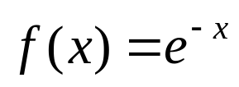
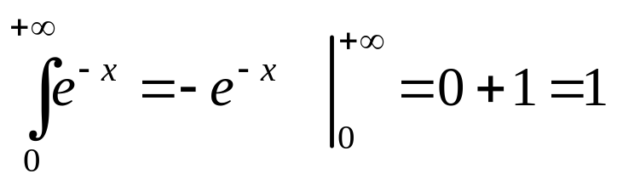
Continuous case
  For example, recall the negative exponential function (in probability, this is called an “exponential distribution”):
  This function integrates to 1:

Slide 19
Continuous case: “probability density function” (pdf)
p(x)=e^{-x}
1
x
The probability that x is any exact particular value (such as 1.9976) is 0; we can only assign probabilities to possible ranges of x.

Slide 20
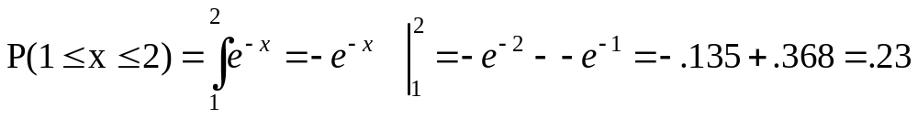
For example, the probability of x falling within 1 to 2:
p(x)=e^{-x}
1
x
1
2

Slide 21
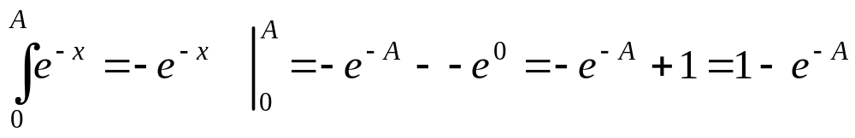
Cumulative distribution function
As in the discrete case, we can specify the “cumulative distribution function” (CDF):
The CDF here = P(x≤A)=

Slide 22
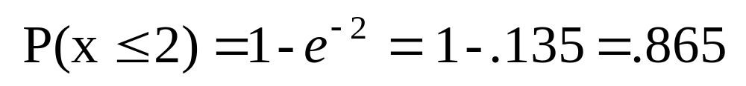
Example
p(x)
1
x
2

Slide 23
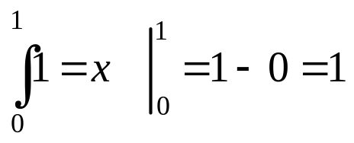
Example 2: Uniform distribution
The uniform distribution: all values are equally likely
The uniform distribution:
f(x)= 1 , for 1≥ x ≥0
p(x)
1
x
1
We can see it’s a probability distribution because it integrates to 1 (the area under the curve is 1):

Slide 24
Example: Uniform distribution
What’s the probability that x is between ¼ and ½?
p(x)
1
¼
½
x
1
P(½ ≥x≥ ¼ )= ¼

Slide 25
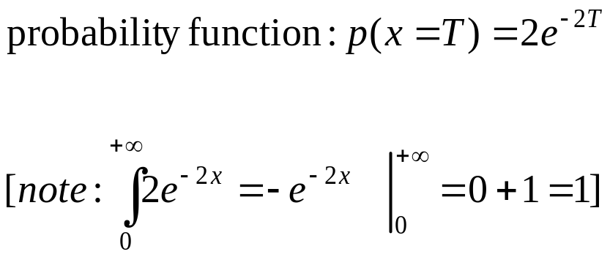
Practice Problem
4. Suppose that survival drops off rapidly in the year following diagnosis of a certain type of advanced cancer. Suppose that the length of survival (or time-to-death) is a random variable that approximately follows an exponential distribution with parameter 2 (makes it a steeper drop off):
What’s the probability that a person who is diagnosed with this illness survives a year?

Slide 26
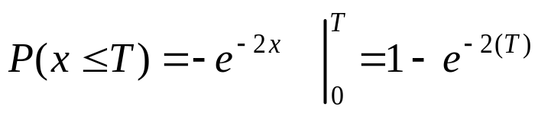

Answer
The probability of dying within 1 year can be calculated using the cumulative distribution function:
Cumulative distribution function is:
The chance of surviving past 1 year is: P(x≥1) = 1 – P(x≤1)

Slide 27
Expected Value and Variance
All probability distributions are characterized by an expected value and a variance (standard deviation squared).

Slide 28
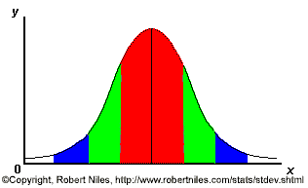
For example, bell-curve (normal) distribution:
One standard deviation from the mean (σ)
Mean (μ)

Slide 29
Expected value, or mean
If we understand the underlying probability function of a certain phenomenon, then we can make informed decisions based on how we expect x to behave on-average over the long-run…(so called “frequentist” theory of probability).
Expected value is just the weighted average or mean (µ) of random variable x. Imagine placing the masses p(x) at the points X on a beam; the balance point of the beam is the expected value of x.

Slide 30
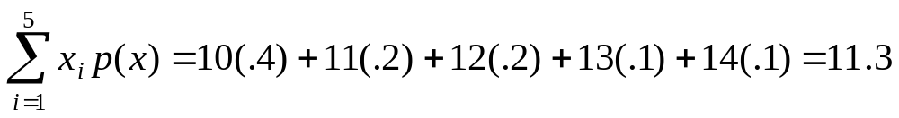
Example: expected value
Recall the following probability distribution of ship arrivals:
x
10
11
12
13
14
P(x)
.4
.2
.2
.1
.1

Slide 31
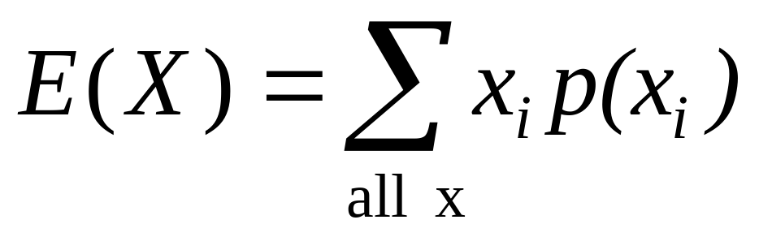
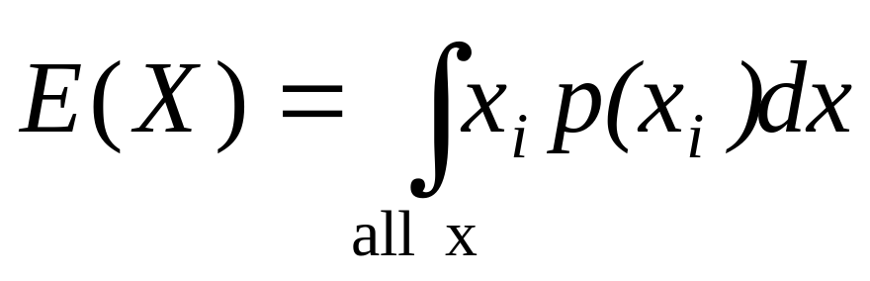
Expected value, formally
Discrete case:
Continuous case:

Slide 32
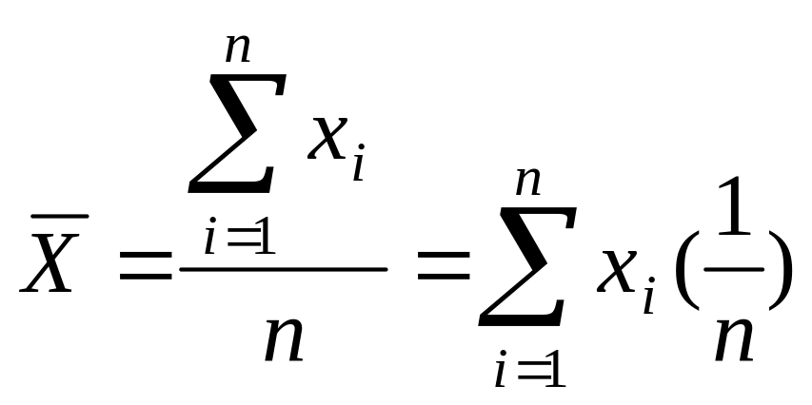
Empirical Mean is a special case of Expected Value…
Sample mean, for a sample of n subjects: =
The probability (frequency) of each person in the sample is 1/n.

Slide 33
Expected value, formally
Discrete case:
Continuous case:

Slide 34
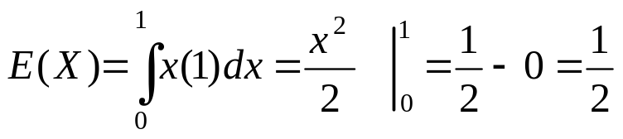
Extension to continuous case: uniform distribution
p(x)
1
x
1

Slide 35
Symbol Interlude
E(X) = µ
  these symbols are used interchangeably

Slide 36
Expected Value
Expected value is an extremely useful concept for good decision-making!

Slide 37
Example: the lottery
The Lottery (also known as a tax on people who are bad at math…)
A certain lottery works by picking 6 numbers from 1 to 49. It costs $1.00 to play the lottery, and if you win, you win $2 million after taxes.
If you play the lottery once, what are your expected winnings or losses?

Slide 38
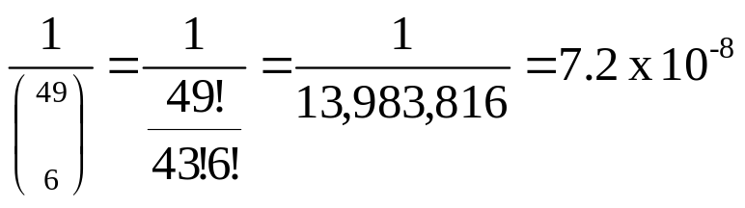
Lottery
Calculate the probability of winning in 1 try:
“49 choose 6”
Out of 49 numbers, this is the number of distinct combinations of 6.
The probability function (note, sums to 1.0):
x$
p(x)
-1
.999999928
+ 2 million
7.2 x 10⁻⁻⁸

Slide 39
Expected Value
The probability function
x$
p(x)
-1
.999999928
+ 2 million
7.2 x 10⁻⁻⁸
Expected Value
E(X) = P(win)*$2,000,000 + P(lose)*-$1.00
= 2.0 x 10⁶ * 7.2 x 10⁻⁸+ .999999928 (-1) = .144 - .999999928 = -$.86
Negative expected value is never good!
You shouldn’t play if you expect to lose money!

Slide 40
Expected Value
If you play the lottery every week for 10 years, what are your expected winnings or losses?
520 x (-.86) = -$447.20

Slide 41
Gambling (or how casinos can afford to give so many free drinks…)
A roulette wheel has the numbers 1 through 36, as well as 0 and 00. If you bet $1 that an odd number comes up, you win or lose $1 according to whether or not that event occurs. If random variable X denotes your net gain, X=1 with probability 18/38 and X= -1 with probability 20/38.
E(X) = 1(18/38) – 1 (20/38) = -$.053
On average, the casino wins (and the player loses) 5 cents per game.
The casino rakes in even more if the stakes are higher:
E(X) = 10(18/38) – 10 (20/38) = -$.53
If the cost is $10 per game, the casino wins an average of 53 cents per game. If 10,000 games are played in a night, that’s a cool $5300.

Slide 42
**A few notes about Expected Value as a mathematical operator:
If c= a constant number (i.e., not a variable) and X and Y are any random variables…
E(c) = c
E(cX)=cE(X)
E(c + X)=c + E(X)
E(X+Y)= E(X) + E(Y)

Slide 43
E(c) = c
E(c) = c
Example: If you cash in soda cans in CA, you always get 5 cents per can.
Therefore, there’s no randomness. You always expect to (and do) get 5 cents.

Slide 44
E(cX)=cE(X)
E(cX)=cE(X)
Example: If the casino charges $10 per game instead of $1, then the casino expects to make 10 times as much on average from the game (See roulette example above!)

Slide 45
E(c + X)=c + E(X)
E(c + X)=c + E(X)
Example, if the casino throws in a free drink worth exactly $5.00 every time you play a game, you always expect to (and do) gain an extra $5.00 regardless of the outcome of the game.

Slide 46
E(X+Y)= E(X) + E(Y)
E(X+Y)= E(X) + E(Y)
Example: If you play the lottery twice, you expect to lose: -$.86 + -$.86.
NOTE: This works even if X and Y are dependent!! Does not require independence!! Proof left for later…

Slide 47
Practice Problem
If a disease is fairly rare and the antibody test is fairly expensive, in a resource-poor region, one strategy is to take half of the serum from each sample and pool it with n other halved samples, and test the pooled lot. If the pooled lot is negative, this saves n-1 tests. If it’s positive, then you go back and test each sample individually, requiring n+1 tests total.
  Suppose a particular disease has a prevalence of 10% in a third-world population and you have 500 blood samples to screen. If you pool 20 samples at a time (25 lots), how many tests do you expect to have to run (assuming the test is perfect!)?
  What if you pool only 10 samples at a time?
  5 samples at a time?

Slide 48
Answer (a)
a. Suppose a particular disease has a prevalence of 10% in a third-world population and you have 500 blood samples to screen. If you pool 20 samples at a time (25 lots), how many tests do you expect to have to run (assuming the test is perfect!)?
Let X = a random variable that is the number of tests you have to run per lot:
E(X) = P(pooled lot is negative)(1) + P(pooled lot is positive) (21)
E(X) = (.90)²⁰ (1) + [1-.90²⁰] (21) = 12.2% (1) + 87.8% (21) = 18.56
E(total number of tests) = 25*18.56 = 464

Slide 49
Answer (b)
b. What if you pool only 10 samples at a time?
E(X) = (.90)¹⁰ (1) + [1-.90¹⁰] (11) = 35% (1) + 65% (11) = 7.5 average per lot
50 lots * 7.5 = 375

Slide 50
Answer (c)
c. 5 samples at a time?
E(X) = (.90)⁵ (1) + [1-.90⁵] (6) = 59% (1) + 41% (6) = 3.05 average per lot
100 lots * 3.05 = 305

Slide 51
Practice Problem
If X is a random integer between 1 and 10, what’s the expected value of X?

Slide 52
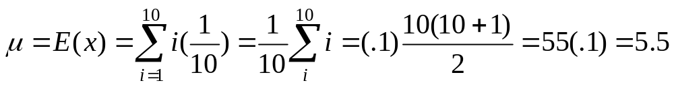
Answer
If X is a random integer between 1 and 10, what’s the expected value of X?

Slide 53
Expected value isn’t everything though…
Take the show “Deal or No Deal”
Everyone know the rules?
Let’s say you are down to two cases left. $1 and $400,000. The banker offers you $200,000.
So, Deal or No Deal?

Slide 54
Deal or No Deal…
This could really be represented as a probability distribution and a non-random variable:
x$
p(x)
+1
.50
+$400,000
.50
x$
p(x)
+$200,000
1.0

Slide 55

Expected value doesn’t help…
x$
p(x)
+1
.50
+$400,000
.50
x$
p(x)
+$200,000
1.0

Slide 56
How to decide?
Variance!
If you take the deal, the variance/standard deviation is 0.
If you don’t take the deal, what is average deviation from the mean?
What’s your gut guess?

Slide 57
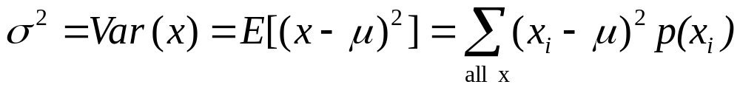
Variance/standard deviation
“The average (expected) squared distance (or deviation) from the mean”
**We square because squaring has better properties than absolute value. Take square root to get back linear average distance from the mean (=”standard deviation”).

Slide 58
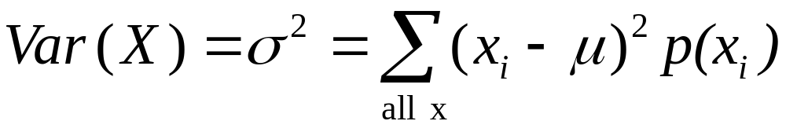
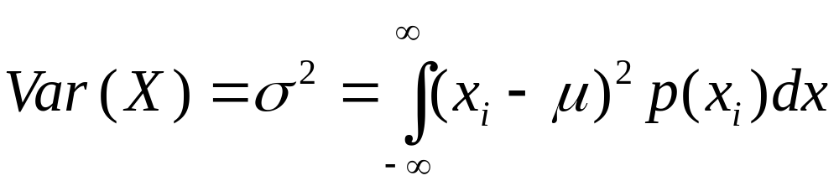
Variance, formally
Discrete case:
Continuous case:

Slide 59
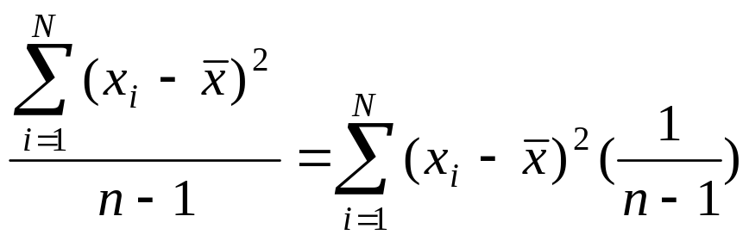
Similarity to empirical variance
The variance of a sample: s² =
Division by n-1 reflects the fact that we have lost a “degree of freedom” (piece of information) because we had to estimate the sample mean before we could estimate the sample variance.

Slide 60
Symbol Interlude
Var(X) = σ²
  these symbols are used interchangeably

Slide 61
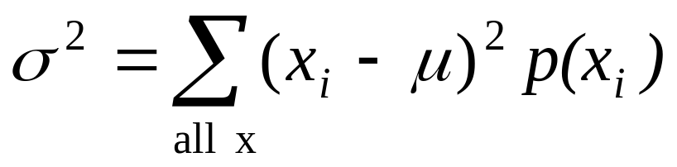
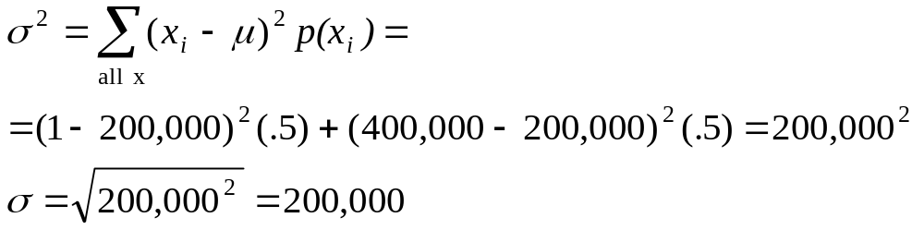
Variance: Deal or No Deal
Now you examine your personal risk tolerance…

Slide 62
Practice Problem
A roulette wheel has the numbers 1 through 36, as well as 0 and 00. If you bet $1.00 that an odd number comes up, you win or lose $1.00 according to whether or not that event occurs. If X denotes your net gain, X=1 with probability 18/38 and X= -1 with probability 20/38.
  We already calculated the mean to be = -$.053. What’s the variance of X?

Slide 63
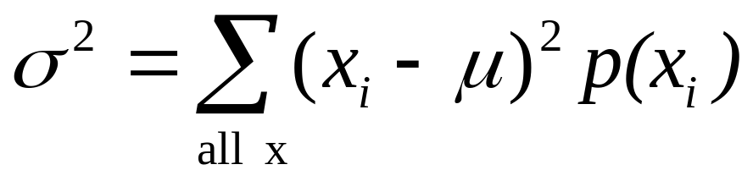
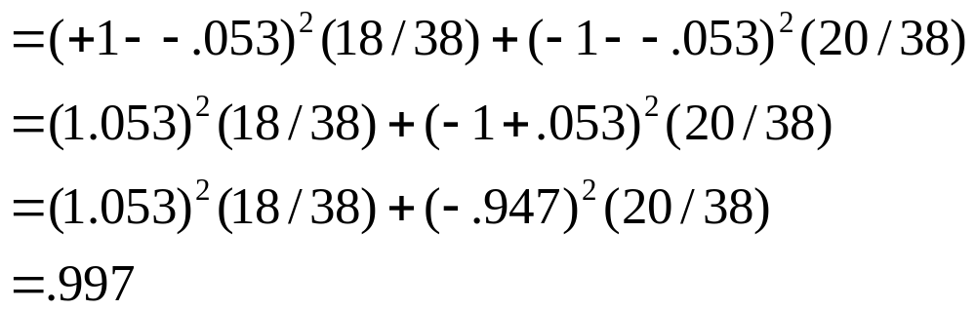
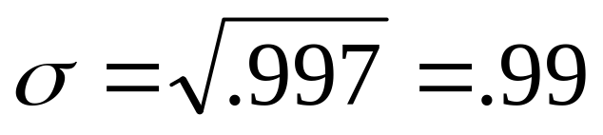
Answer
Standard deviation is $.99. Interpretation: On average, you’re either 1 dollar above or 1 dollar below the mean, which is just under zero. Makes sense!

Slide 64
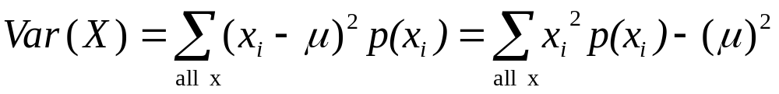
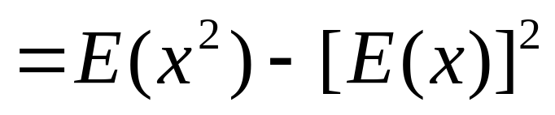
Handy calculation formula!
Handy calculation formula (if you ever need to calculate by hand!):
Intervening algebra!

Slide 65
Var(x) = E(x-μ)² = E(x²) – [E(x)]² (your calculation formula!)
Proofs (optional!):
E(x-μ)² = E(x²–2μx + μ²) remember “FOIL”?!
=E(x²) – E(2μx) +E(μ²) Use rules of expected value:E(X+Y)= E(X) + E(Y)
= E(x²) – 2μE(x) +μ² E(c) = c
= E(x²) – 2μμ +μ² E(x) = μ
= E(x²) – μ²
= E(x²) – [E(x)]²
OR, equivalently:
E(x-μ)² =

Slide 66
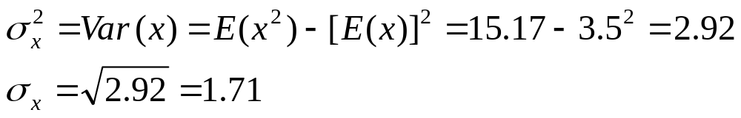
For example, what’s the variance and standard deviation of the roll of a die?
x
p(x)
1
p(x=1)=1/6
p(x)
average distance from the mean
2
p(x=2)=1/6
3
p(x=3)=1/6
4
p(x=4)=1/6
1/6
5
p(x=5)=1/6
1
2
3
4
5
6
x
6
p(x=6)=1/6
1.0
mean

Slide 67
**A few notes about Variance as a mathematical operator:
If c= a constant number (i.e., not a variable) and X and Y are random variables, then
Var(c) = 0
Var (c+X)= Var(X)
Var(cX)= c²Var(X)
Var(X+Y)= Var(X) + Var(Y) ONLY IF X and Y are independent!!!!
{Var(X+Y)= Var(X) + Var(Y)+2Cov(X,Y) IF X and Y are not independent}

Slide 68
Var(c) = 0
Var(c) = 0
Constants don’t vary!

Slide 69

Var (c+X)= Var(X)
Var (c+X)= Var(X)
Adding a constant to every instance of a random variable doesn’t change the variability. It just shifts the whole distribution by c. If everybody grew 5 inches suddenly, the variability in the population would still be the same.
+ c

Slide 70
Var (c+X)= Var(X)
Var (c+X)= Var(X)
Adding a constant to every instance of a random variable doesn’t change the variability. It just shifts the whole distribution by c. If everybody grew 5 inches suddenly, the variability in the population would still be the same.
+ c

Slide 71
Var(cX)= c²Var(X)
Var(cX)= c²Var(X)
Multiplying each instance of the random variable by c makes it c-times as wide of a distribution, which corresponds to c² as much variance (deviation squared). For example, if everyone suddenly became twice as tall, there’d be twice the deviation and 4 times the variance in heights in the population.

Slide 72
Var(X+Y)= Var(X) + Var(Y)
Var(X+Y)= Var(X) + Var(Y) ONLY IF X and Y are independent!!!!!!!!
With two random variables, you have more opportunity for variation, unless they vary together (are dependent, or have covariance): Var(X+Y)= Var(X) + Var(Y) + 2Cov(X, Y)

Slide 73
Example of Var(X+Y)= Var(X) + Var(Y): TPMT
TPMT metabolizes the drugs 6- mercaptopurine, azathioprine, and 6-thioguanine (chemotherapy drugs)
People with TPMT^{-/} TPMT⁺ have reduced levels of activity (10% prevalence)
People with TPMT^{-/} TPMT⁻ have no TPMT activity (prevalence 0.3%).
They cannot metabolize 6- mercaptopurine, azathioprine, and 6-thioguanine, and risk bone marrow toxicity if given these drugs.

Slide 74
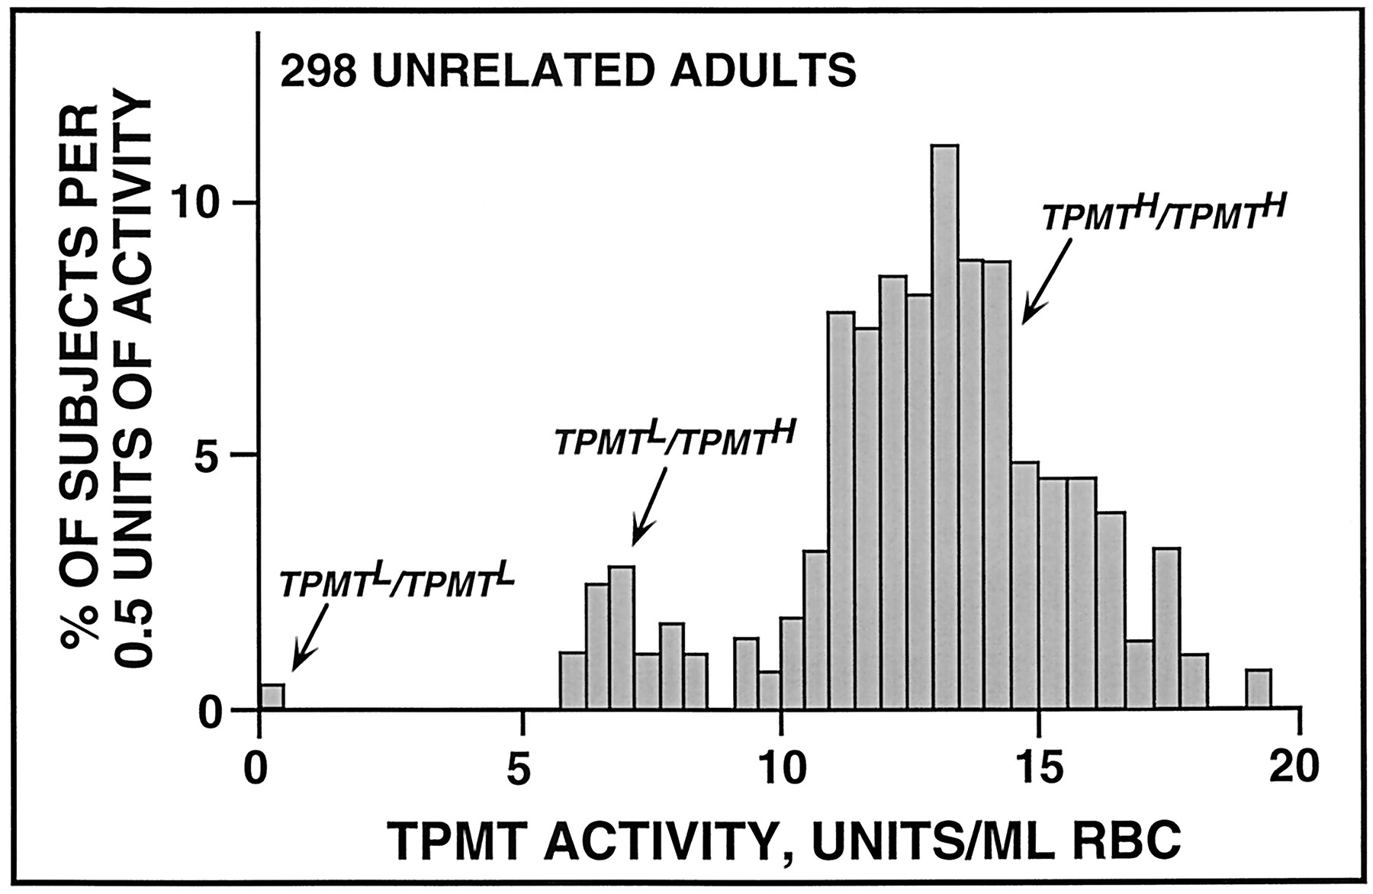
TPMT activity by genotype
  Weinshilboum R. Drug Metab Dispos. 2001 Apr;29(4 Pt 2):601-5

Slide 75
TPMT activity by genotype
The variability in TPMT activity is much higher in wild-types than heterozygotes.
  Weinshilboum R. Drug Metab Dispos. 2001 Apr;29(4 Pt 2):601-5

Slide 76
TPMT activity by genotype
There is variability in expression from each wild-type allele. With two copies of the good gene present, there’s “twice as much” variability.
No variability in expression here, since there’s no working gene.
  Weinshilboum R. Drug Metab Dispos. 2001 Apr;29(4 Pt 2):601-5

Slide 77
Practice Problem
Find the variance and standard deviation for the number of ships to arrive at the harbor (recall that the mean is 11.3).
x
10
11
12
13
14
P(x)
.4
.2
.2
.1
.1

Slide 78
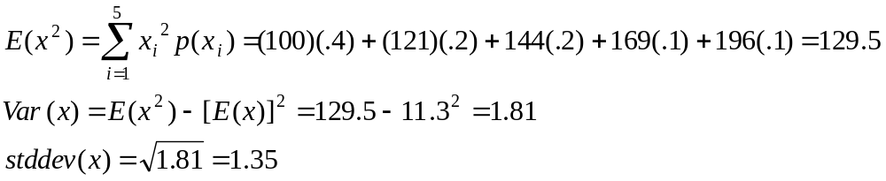
Answer: variance and std dev
x²
100
121
144
169
196
P(x)
.4
.2
.2
.1
.1
Interpretation: On an average day, we expect 11.3 ships to arrive in the harbor, plus or minus 1.35. This gives you a feel for what would be considered a usual day!

Slide 79
Practice Problem
You toss a coin 100 times. What’s the expected number of heads? What’s the variance of the number of heads?

Slide 80
Answer: expected value
Intuitively, we’d probably all agree that we expect around 50 heads, right?
Another way to show this→
Think of tossing 1 coin. E(X=number of heads) = (1) P(heads) + (0)P(tails)
∴E(X=number of heads) = 1(.5) + 0 = .5
If we do this 100 times, we’re looking for the sum of 100 tosses, where we assign 1 for a heads and 0 for a tails. (these are 100 “independent, identically distributed (i.i.d)” events)
E(X₁ +X₂ +X₃ +X₄ +X₅ …..+X₁₀₀) = E(X₁) + E(X₂) + E(X₃)+ E(X₄)+ E(X₅) …..+ E(X₁₀₀) =
100 E(X₁) = 50

Slide 81
Answer: variance
What’s the variability, though? More tricky. But, again, we could do this for 1 coin and then use our rules of variance.
Think of tossing 1 coin.
E(X²=number of heads squared) = 1² P(heads) + 0² P(tails)
∴E(X²) = 1(.5) + 0 = .5
Var(X) = .5 - .5² = .5 - .25 = .25
Then, using our rule: Var(X+Y)= Var(X) + Var(Y) (coin tosses are independent!)
Var(X₁ +X₂ +X₃ +X₄ +X₅ …..+X₁₀₀) = Var(X₁) + Var(X₂) + Var(X₃)+ Var(X₄)+ Var(X₅) …..+ Var(X₁₀₀) =
100 Var(X₁) = 100 (.25) = 25
SD(X)=5
Interpretation: When we toss a coin 100 times, we expect to get 50 heads plus or minus 5.

Slide 82
Or use computer simulation…
Flip coins virtually!
  Flip a virtual coin 100 times; count the number of heads.
  Repeat this over and over again a large number of times (we’ll try 30,000 repeats!)
  Plot the 30,000 results.

Slide 83
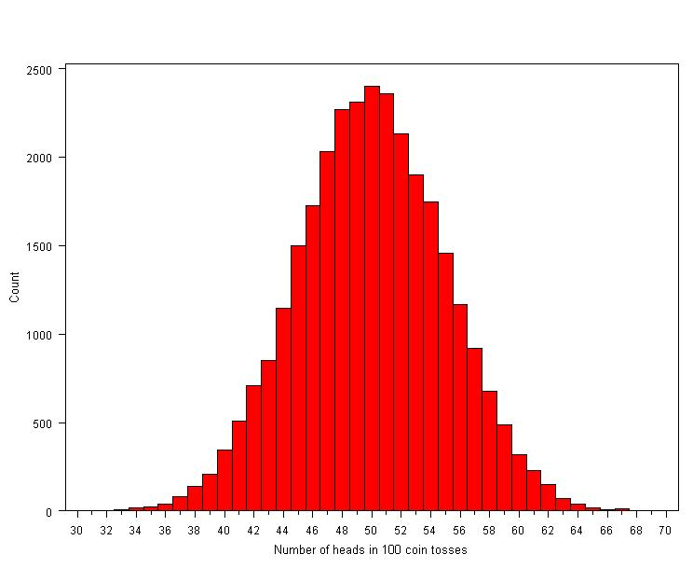
Coin tosses…
Mean = 50
Std. dev = 5
Follows a normal distribution
∴95% of the time, we get between 40 and 60 heads…

Slide 84
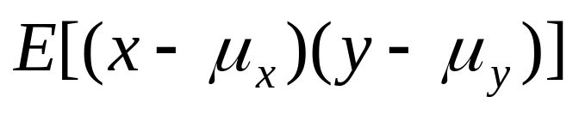
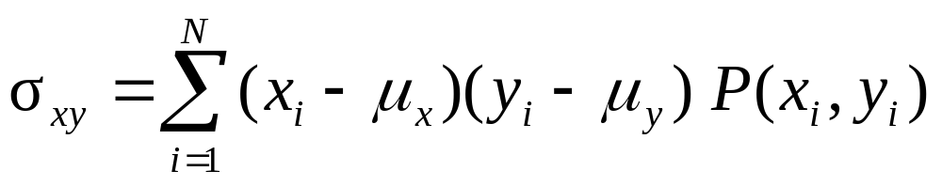
Covariance: joint probability
The covariance measures the strength of the linear relationship between two variables
The covariance:

Slide 85
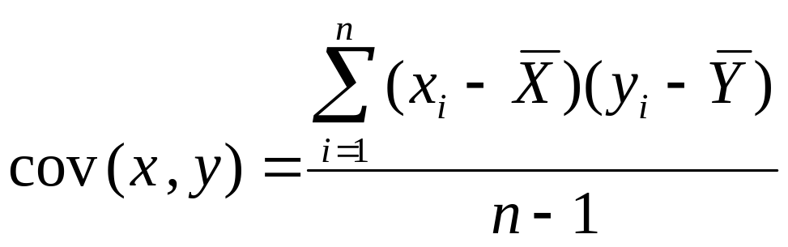
The Sample Covariance
The sample covariance:

Slide 86
Interpreting Covariance
Covariance between two random variables:
cov(X,Y) > 0 X and Y are positively correlated
cov(X,Y) < 0 X and Y are inversely correlated
cov(X,Y) = 0 X and Y are independent

